Slide 1
Orienteering problem with stochastic service times

Slide 2
Description
Let us consider graph with N nodes. Each node is assigned a stochastic service time and profit, potentially also stochastic.
The goal is to find a route which maximizes profit, visiting each node not more than once with possibility of exceeding time limit not more than α.

Slide 3
Current assumptions
Service time is discrete with estimated distribution.
Profits are discrete and fixed.
Travel times smaller are fixed.
N is small (<20).

Slide 4
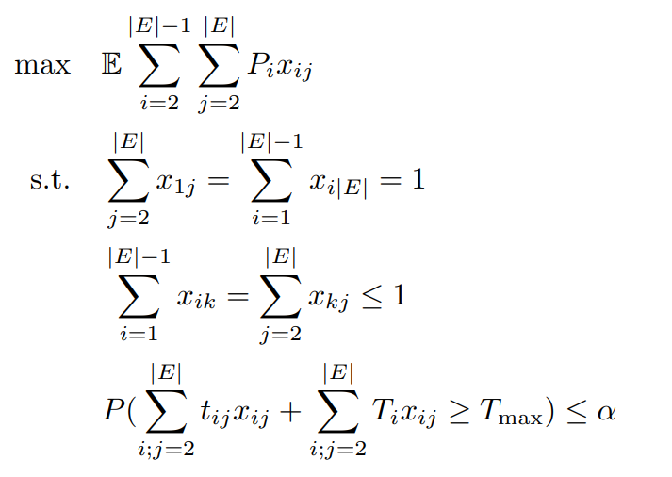
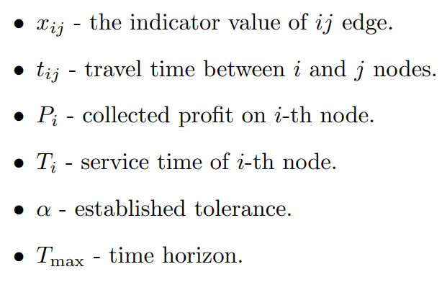
Formulation

